Slide 1
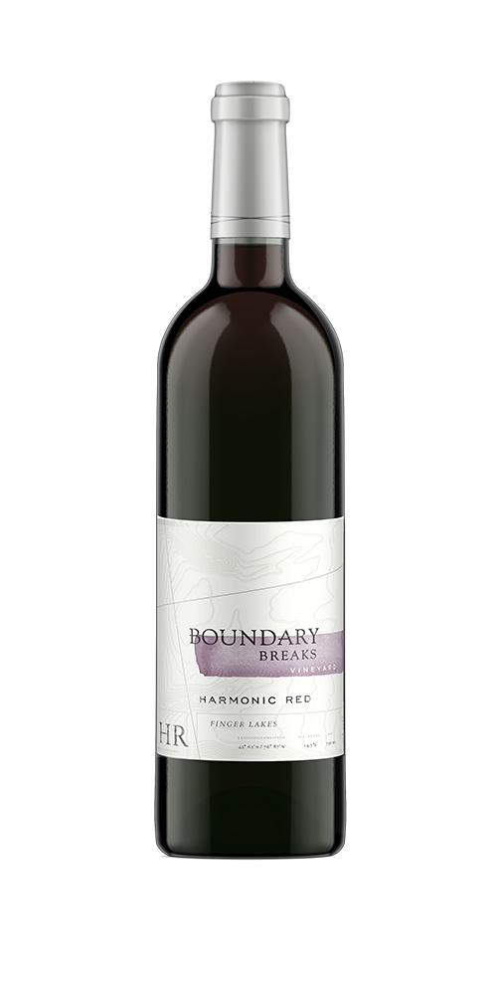
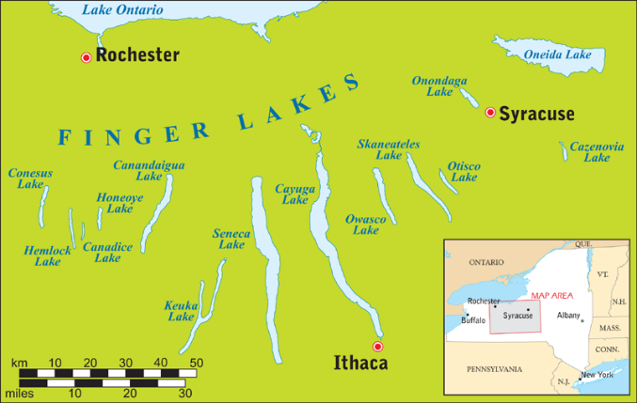
DID YOU KNOW?
Cooler Climate Reds are Just as Good!
-- Cooler Climate Reds are lower in alcohol which makes them more food friendly!
-- The Finger Lakes is a perfect climate to grow some of the world’s best Cab Francs.
-- Vineyards on the east side of Seneca Lake are in a microclimate called the “Banana Belt” due to slightly warmer temperatures.
2017 Harmonic Red
WHAT MAKES HARMONIC RED SPECIAL
--We employ vineyard techniques that seek to achieve small berry size which yields sufficient color and structure, while exhibiting lots of fruit in the finished wine. --The specific vineyard practices enable us to produce uncommonly ripe fruit in a cool climate, which yields structured, full-bodied wine. --In the unusual 2017 vintage, we blended this Bordeaux-style wine to be more fruit-driven. The Merlot component is larger than in prior vintages.
2017 VINTAGE NOTES
The summer of 2017 was unseasonably cool. Fruit was less ripe than normal into mid-September. Then, fortunately, six weeks of warm, dry weather followed enabling fruit to hang on the vines longer than usual.
TECHNICAL NOTES
Country: USA Region: New York AVA: Finger Lakes Varietal: 56% Merlot; 33% Cabernet Sauvignon, 11% Cabernet Franc. Harvest Date: Oct. 25th 2017 Brix at Harvest: 22 Winemaker: David Breeden | Fermentation: : Conventional primary fermentation; aged 10 mos. in 2 y/o French Oak Alcohol: 13% Residual Sugar: 0 Titratable Acidity: 5.9 g/l pH: 3.42 Bottling Date: Sept 1, 2018 Cases Produced: 500; SRP: $27.95
SELLING POINTS: HARMONIC RED
“Medium dark ruby in color. The aromas have a sweet confectionary or liqueur-like quality, with scents of blueberry, raspberry and black currant inflected with cedar, cocoa, graphite and a touch of acetic acid. The finish is soft and gritty, with very good persistence of slightly sour berry fruit.” – Douglas Hillstrom (www.fingerlakeswines.info)
ABOUT US:, Boundary Breaks focuses on cool-climate grape varieties--principally Riesling, Gewurztraminer and Cabernet Franc. We began planting vines in 2009 and released our first vintage in 2013. Our wines are sold throughout the US and abroad.
WHAT MAKES OUR WINES DISTINCTIVE: Our wines possess a powerful flavor profile. We achieve this in the challenging cool climate of the Finger Lakes by ensuring our fruit achieves a maximum level of ripeness in the vineyard. Our vineyards are located in a unique microclimate near the shoreline on the east side of Seneca Lake. The lake is more than 700 feet deep and keeps our site warmer during the coldest periods of winter. Our western-facing vineyard slopes also benefit from extended afternoon sun.
Boundary
Breaks
Boundary Breaks 1568 Porter Covert Rd., Lodi, NY 14860 info@boundarybreaks.com 607-474-5030 www.boundarybreaks.com

